Slide 1
SRM INSTITUTE OF SCIENCE AND TECHNOLOGY, CHENNAI
ARTIFICIAL NEURAL NETWORKS
UNIT - I
Department: AIML-B,C
Staff Name: L.Sasikala

Slide 2
Unit – I
Introduction, motivation and history
Why neural network?
Basics of Artificial Neural Networks
A brief history of neural networks
Biological neural networks
The vertebrate nervous system
Peripheral nervous system
Cerebrum, Cerebellum, Diencephalon, Brainstem
The Neuron
Components
Electrochemical processes
Receptor cells- Various types
Information processing within nervous System
Light sensing organs
Neurons in living organisms
Transitions to technical neurons

Slide 3
Learning Resources
David Kriesel, “A Brief Introduction to Neural Networks”, dkriesel.com, 2005
Gunjan Goswami, “Introduction to Artificial Neural Networks”, S.K. Kataria& Sons, 2012
Raul Rojas, “Neural Networks: A Systematic Introduction”, 1996.
S. Sivanandam, “Introduction to Artificial Neural Networks”, 2003.

Slide 4
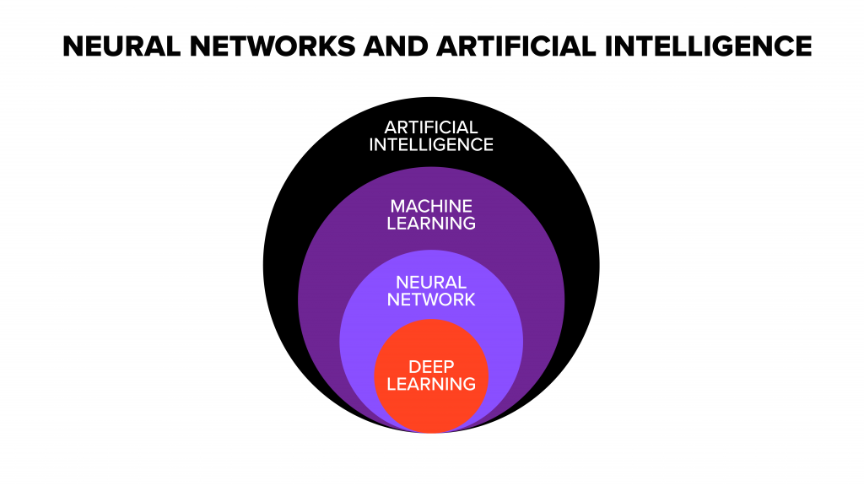

Slide 5
Artificial Intelligence (AI)
It enables the machine to think without any human intervention.
It is the ability of machines to function like the human brain.
AI Applications –
Handwriting, Speech and Face recognition.
Robotic vacuum cleaners.
Virtual assistants like Amazon Alexa and Android SIRI.
Robots that perform surgeries in healthcare .
Chess games, Ludo.
Robots that write codes.
Self-driving cars and trucks.

Slide 6
Machine Learning (ML)
It is naturally a subset of AI.
It uses statistical learning algorithms or methods to build systems that have the ability to automatically learn and improve from experiences without being explicitly programmed.
It allows a system to learn to recognize patterns on its own and make predictions.
ML Applications -
Netflix .
Youtube.
Spotify.
Search engines like google and yahoo.

Slide 7
Deep Learning (DL)
It is a subset of machine learning.
It uses some machine learning techniques to solve real-world problems by tapping into neural networks that simulate human decision-making.
Deep learning can be costly and requires huge datasets to train itself.
Learning can be supervised (past data) and unsupervised.
Also referred as Deep neural networks.
It is a particular kind of machine learning method based on artificial neural networks that allows computers to do what comes naturally to humans.
For example, a deep learning algorithm could be trained to ‘learn’ how a dog looks like and trained to distinguish a dog from a wolf or a fox.

Slide 8
Artificial Neural Network (ANN)
Artificial – Not natural, it’s a man made.
Neural – Related to neurons or nerve cells.
Network - A group of people or things interconnected in order to interact with each other to exchange information for some development.
Artificial neural network or Neural network or just Neural net.
The term "Artificial Neural Network" is derived from “Biological neural networks” that develops the structure of a human brain.
The inventor of the first neuro computer, Dr. Robert Hecht-Nielsen, defines a neural network as, "... a computing system made up of a number of simple, highly interconnected processing elements, which process information by their dynamic state response to external inputs.”

Slide 9
Introduction, motivation and history
Why Neural Network?
Humans have a brain, Computers have some processing units and memory.
Humans can learn, whereas Computers cannot learn.
Living beings do not have any program for developing their skills, which then only has to be executed.
Computer performs the most complex numerical calculations in a very short time, using a program.
A computer is static, has more passive data storage.
Human brain is very simple but numerous nerve cells that work massively in parallel and have the capability to learn.

Slide 10
The said characteristics of a human is implemented successfully with the help ANN.
Self-organization
Capability to learn
Parallelism
Generalize and associate data.
Fault tolerance.
History, development, decline and resurgence of a wide approach to solve problems.

Slide 11
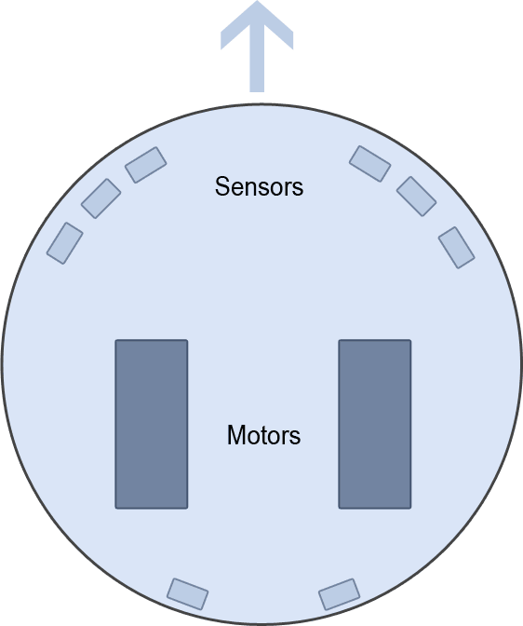
A small robot with eight sensors and two motors. The arrow indicates the driving direction.

Slide 12
The classical way
It has eight distance sensors from which it extracts input data.
Three sensors are placed on the front right, three on the front left, and two on the back.
Each sensor provides a real numeric value at any time.
We always receive an input I ∈ R⁸.
It shall only drive on but stop when it collide with an obstacle.
Output is binary:
H = 0 for "Everything is okay, drive on" and
H = 1 for "Stop, The output is called H for halt signal".
Mapping
f : R⁸ → B¹

Slide 13
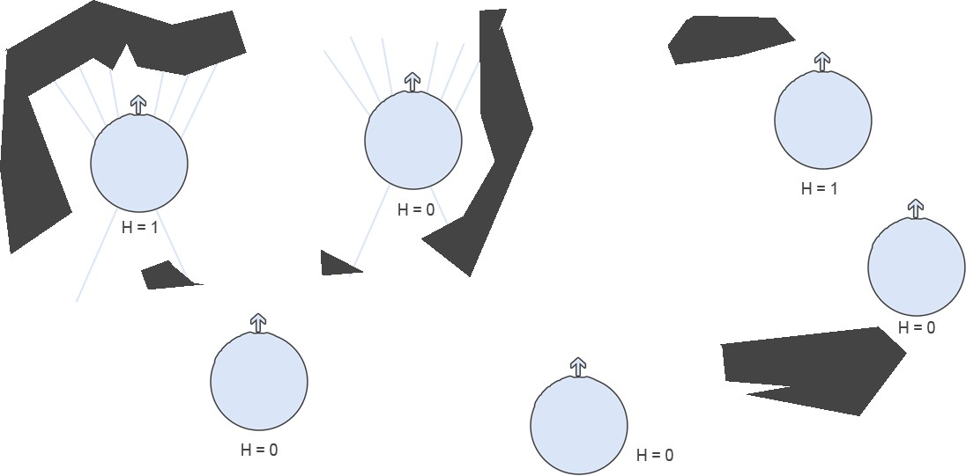
The way of learning

Slide 14
The way of learning
We show different possible situations to the robot.
The robot shall learn on its own what to do.
Neural network as a kind of black box.
Training samples.
Learning procedure is a simple algorithm or a mathematical formula.
The neural network will generalize from these samples and find a universal rule.
Now the mapping is
f : R⁸ → R²
The robot queries the network and changes its position, the sensor values are changed once again, and so on.
The two motors controlled by means of the sensor inputs.

Slide 15

Basics of Artificial Neural Networks

Slide 16
Basics of Artificial Neural Networks
Components of a neuron
Dendrites − They are tree-like branches, responsible for receiving the information from other neurons it is connected to.
Soma − It is the cell body of the neuron and is responsible for processing of information, they have received from dendrites.
Axon − It is just like a cable through which neurons send the information.
Synapses − The space between the axon and other neuron dendrites.
There is a direct, strong, unadjustable connection between the signal transmitter and the signal receiver.

Slide 17
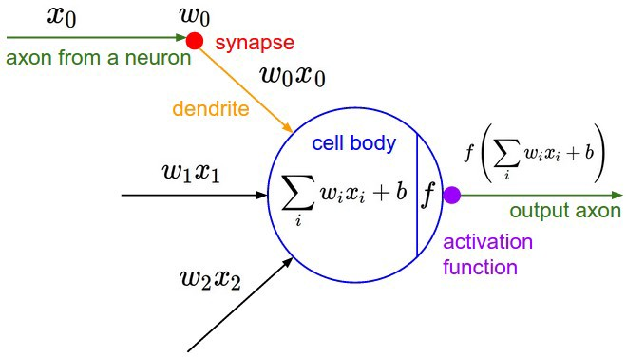
Common mathematical model

Slide 18
Basics of Artificial Neural Networks
The basic unit of computation in a neural network is the neuron also called as Node or Unit.
It receives input from some other nodes, or from an external source and computes an output.
Each input has an associated weight (w), which is assigned on the basis of its relative importance to other inputs.
Excitory (positive weight) or inhibitory (negative weight) of one neuron on another.
Output is given to other neuron through axon terminals.
A single-layer perceptron is the basic unit of a neural network. A perceptron consists of input values, weights and a bias, a weighted sum and activation function.

Slide 19
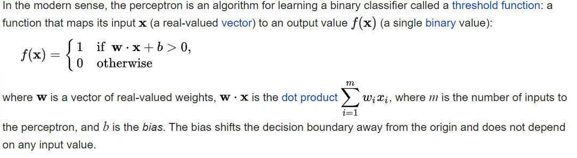



Slide 20
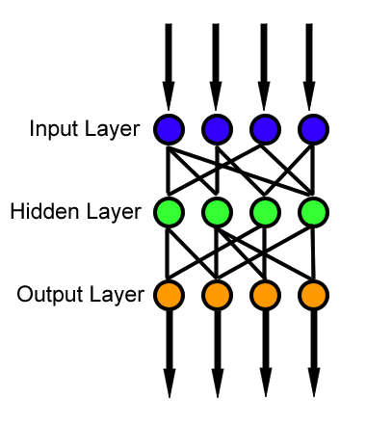
Neural Network Architecture

Slide 21
Input nodes (input layer):
No computation is done here within this layer.
Passes the information to the next layer (hidden layer most of the time).
A block of nodes is also called layer.
Hidden nodes (hidden layer):
Intermediate processing or computation is done here.
Transfer the weights (signals or information) from the input layer to the following layer (another hidden layer or to the output layer).
Output Nodes (output layer):
We finally use an activation function that maps to the desired output format.

Slide 22
Connections and weights:
The network consists of connections, each connection transferring the output of a neuron “i” to the input of a neuron ”j”.
In this sense ”i” is the predecessor of ”j” and ”j” is the successor of ”i”, each connection is assigned a weight W.
Activation function:
Activation function decides, whether a neuron should be activated or not, by calculating weighted sum and further adding bias with it.
Function is also called the Transfer function.
Learning rule:
Is a rule or an algorithm which modifies the parameters of the neural network, in order for a given input to the network to produce a favored output.

Slide 23


Slide 24
History of Neural Network
ANN during 1940s to 1960s
1943 − The concept of neural network started with the work of physiologist Warren McCulloch, and mathematician Walter Pitts, they modeled a simple neural network using electrical circuits in order to describe how neurons in the brain might work.
1949 − Donald Hebb’s book, ”The Organization of Behavior”, put forth the fact that the connection between two neurons is strengthened when both neurons are active at the same time. This change in strength is proportional to the product of the two activities.

Slide 25
1956 − An associative memory network was introduced by Taylor, which means they can store different patterns and at the time of giving an output they can produce one of the stored patterns by matching them with the given input pattern.
1958 − A learning method for McCulloch and Pitts, neuron model named Perceptron was invented by Rosenblatt.
1960 − Bernard Widrow and Marcian Hoff developed models called "ADALINE“(Adaptive Linear Neural Element Network) and “MADALINE.”

Slide 26
ANN during 1960s to 1980s
1961 − Rosenblatt made an unsuccessful attempt but proposed the “Backpropagation” scheme for networks.
1964 − Taylor constructed a winner-take-all circuit with inhibitions among output units, only one node in the output layer will be active, namely the one corresponding to the strongest input.
1969 − Multilayer perceptron (MLP) was invented by Minsky and Papert.
1971 − Kohonen developed Associative memories.
1976 − Stephen Grossberg and Gail Carpenter developed Adaptive resonance theory, as the name suggests, is always open to new learning “Adaptive”, without losing the old patterns “resonance”.

Slide 27
ANN from 1980s till Present
1982 − Teuvo Kohonen described the self-organizing feature maps know as Kohonen maps. SOM doesn’t learn by backpropagation, it use competitive learning to adjust weights in neurons. He was looking for the mechanisms involving self-organization in the brain.
1983 − Fukushima, Miyake and Ito introduced the neural model of Necognitron, which could recognize handwritten characters.
1985 − John Hopfield published an article describing a way of finding acceptable solutions for Travelling Salesman problem using Hopfiled nets.
1986 − The backpropagation of error learning procedure as a generalization of the Delta rule was developed and published by Parallel Distributed Processing Group.

Slide 28
Biological neural networks
The vertebrate nervous system
Animal Kingdom is divided into two groups: Vertebrates and Invertebrates.
Vertebrates are animals with a backbone inside their bodies, Ex: Fish, dogs and humans.
Invertebrates do not have a skeleton, Ex: spiders, flies and caterpillars.
Vertebrates are often larger and have more complex bodies than invertebrates.
The entire information processing system is called nervous system.
The nervous system is an organ system containing a network of specialized cells called neurons.
It consists of the central nervous system and the peripheral nervous system.

Slide 29
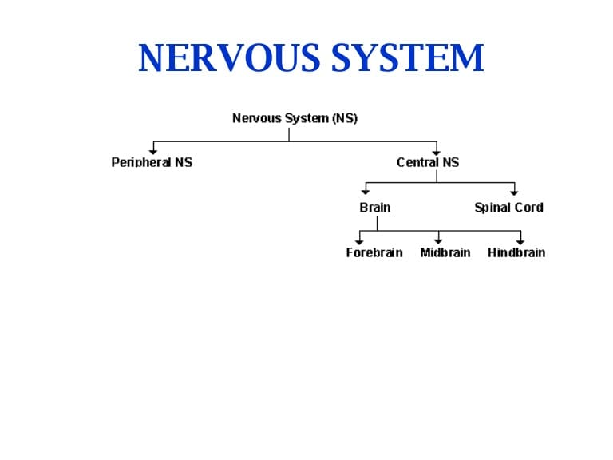

Slide 30
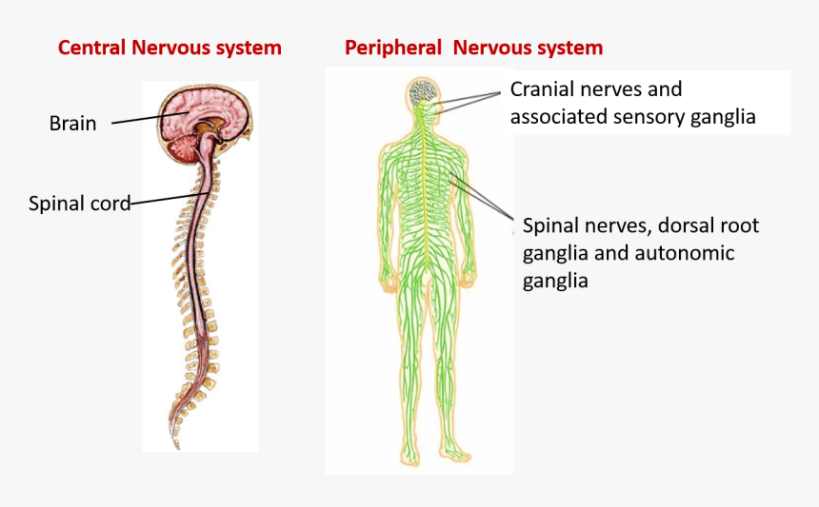

Slide 31
Peripheral nervous system
PNS comprises the nerves that are situated outside of the brain or the spinal cord.
Forms a branched and very dense network throughout the body.
Unlike the CNS, the PNS is not protected by the bone of spine and skull.
The PNS has three basic functions:
Conveying motor commands to all voluntary muscles in the body.
Carrying sensory information about the external world and the body to the brain and spinal cord.
Regulating autonomic functions such as heartbeat, blood flow, breathing, digestion and sweating.

Slide 32
The central nervous system
The vertebrate central nervous system consists of the brain and the spinal cord.
It is the place where information received by the sense organs are stored and managed.
CNS controls most functions of the body and mind.
The brain is the center of our thoughts, the interpreter of our external environment, and the origin of control over body movement.
The spinal cord is the highway for communication between the body and the brain.
When the spinal cord is injured, the exchange of information between the brain and other parts of the body is disrupted.
Brain is categorized into 4 parts.
Forebrain, Midbrain, Hindbrain and Brain stem.

Slide 33
Cerebrum (Forebrain)
The largest part of the brain, forebrain also called as Telencephalon.
Along an axis, running from the lateral face to the back of the head.
Divided into two hemi-spheres, which are organized in a folded structure.
These cerebral hemispheres are connected by one strong nerve cord called nerve bar and several small ones.
The cerebrum is responsible for abstract thinking processes.
A large number of neurons are located in the cerebral cortex (Grey colored layer), 2 to 4cm thick, and divided into different cortical fields.
Primary cortical fields - responsible for processing qualitative information. (Ex. primary auditory cortex , primary visual cortex)
Association cortical fields - perform more abstract association and thinking. (Ex: Decision making, Reasoning, Planning, Problem solving)

Slide 34
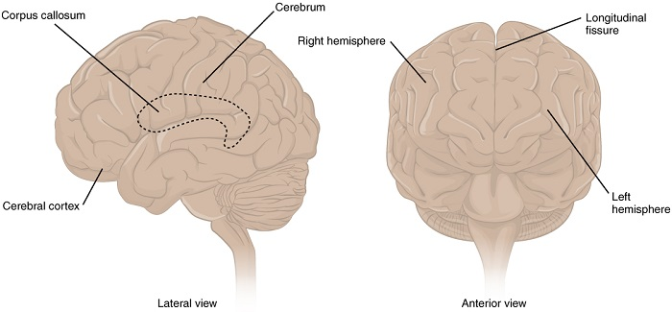

Slide 35
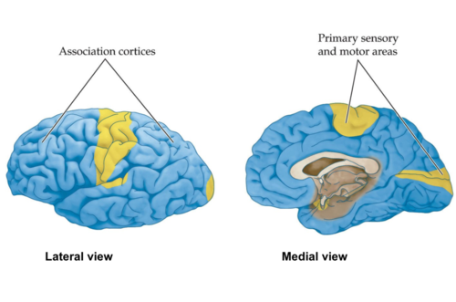

Slide 36
Cerebellum (Hindbrain)
The cerebellum located below the cerebrum, closer to the spinal cord.
Hindbrain also called as Rhombencephalon.
It’s main functions are motor coordination, posture maintenance and balance.
It receives messages about more abstract motor signals coming from the cerebrum.
It is not always associated with memory like Forebrain.
Comparatively smaller in size.
The cerebrum comprises about 83% of the total brain whereas the cerebellum constitutes only about 11%.

Slide 37
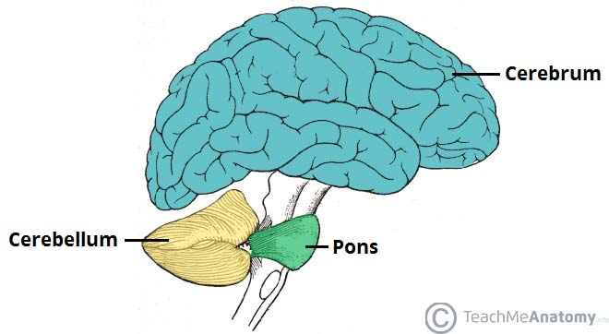

Slide 38
Diencephalon (Midbrain / Interbrain)
It controls fundamental physiological processes.
Mediates between sensory & motor signals and the cerebrum.
Diencephalon includes thalamus which filters incoming data.
Thalamus decides which part of the information is transferred to the cerebrum.
It suppress less important sensory perceptions at short notice to avoid overloads.
Diencephalon also includes hypothalamus, which controls a number of processes within the body.
It also involved in internal clock and the sensation of pain.
The thalamus regulates sleep, alertness and wakefulness, whereas the hypothalamus regulates body temperature, hunger, fatigue and metabolic processes in general.

Slide 39
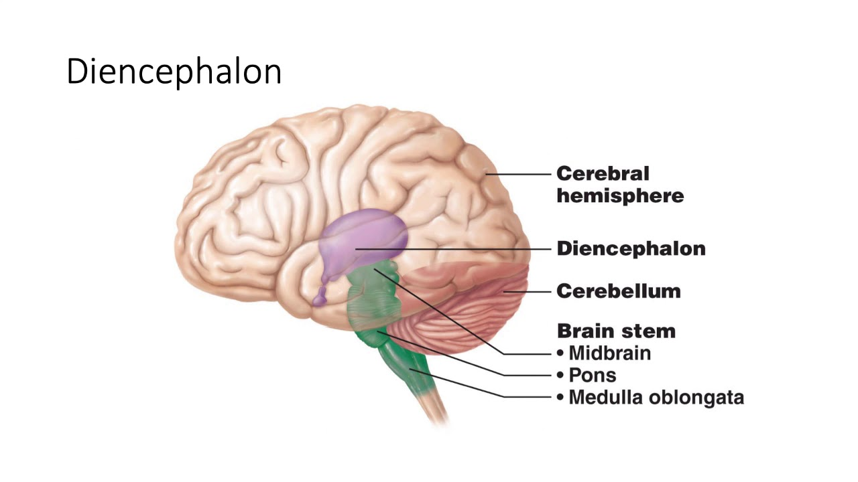

Slide 40
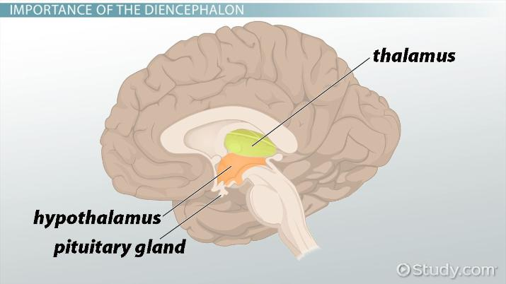

Slide 41
Brain stem
It is the extended spinal cord and thus the connection between brain and spinal cord.
It controls reflexes (such as the blinking reflex or coughing).
Brain stem is also called as Truncus cerebri.
Component pons (bridge), a kind of transit station for many nerve signals from brain to body and vice versa.
If the pons is damaged, then the result could be the Locked-in syndrome.
A patient is “Walled-in” within his own body.
He is conscious and aware with no loss of cognitive function, but cannot move.
Senses of sight, hearing, touch, smell and taste are generally works, able to communicate with others by blinking or moving their eyes.

Slide 42
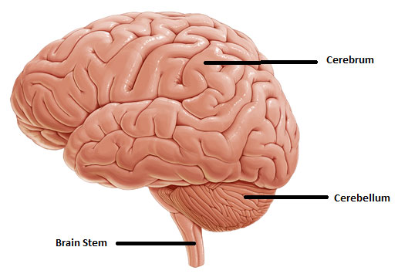

Slide 43
Neurons
Neurons or nerve cells are the fundamental units of the brain and nervous system.
Neurons are responsible for carrying information throughout the human body.
It uses electrical and chemical signals.
In short, our nervous systems detect:
What is going on around us and inside of us.
They decide how we should act.
Alter the state of internal organs (heart rate changes, for instance).
Allows us to think.
Remember what is going on.

Slide 44
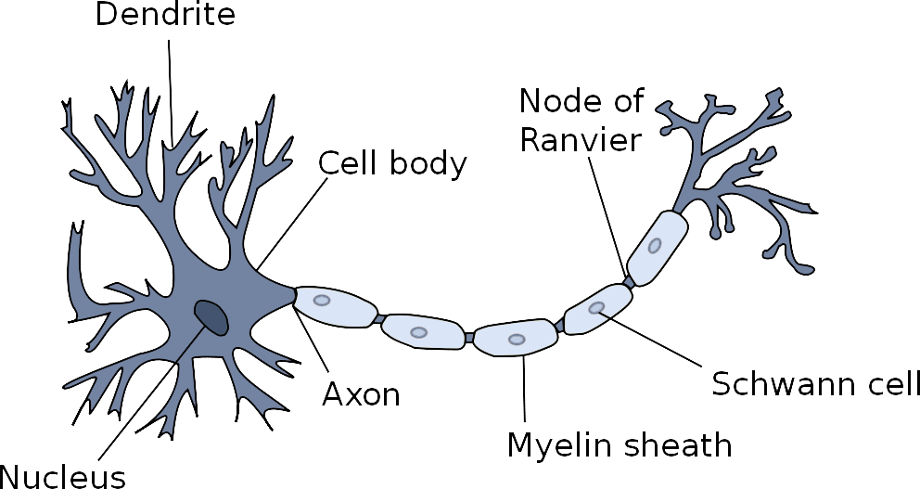

Slide 45
Dendrites branch like trees receive electrical signals from many different sources, which are then transferred into the nucleus of the cell.
The amount of branching dendrites is also called Dendrite tree.
The cell nucleus (Soma) receives a plenty of activating (stimulating) and inhibiting (diminishing) signals by dendrites, the soma accumulates these signals.
If the accumulated signal exceeds a threshold value, the cell nucleus activates an electrical pulse which then is transmitted to the neurons connected to the current one.
The pulse is transferred to other neurons by means of the Axon.
The axon is a long, slender extension of the soma.
The way the electrical information takes within the neuron.
Incoming signals from other neurons or cells are transferred to a neuron by special connections, the synapses.

Slide 46
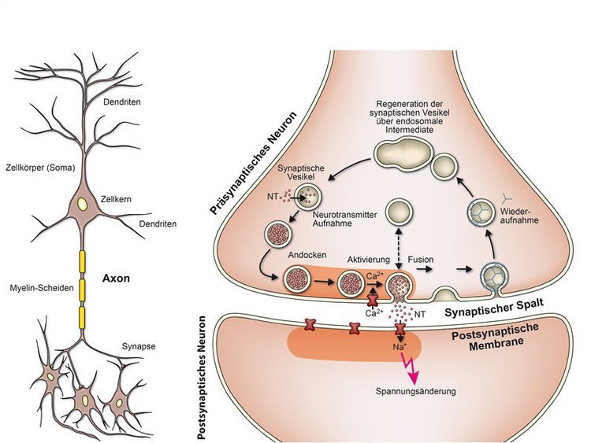

Slide 47
An electrical signal received by the synapse, i.e. coming from the presynaptic side, is directly transferred to the postsynaptic nucleus of the cell.
The electrical coupling of source and target does not take place, the coupling is interrupted by the synaptic cleft.
This cleft electrically separates the presynaptic side from the postsynaptic one.
The information that flow is not an electrical, but a chemical process.
On the presynaptic side of the synaptic cleft the electrical signal is converted into a chemical signal.
A process induced by chemical cues released there is called Neuro- transmitters.
Neurotransmitters cross the synaptic cleft and transfer the information into the nucleus of the cell, where it is reconverted into electrical in formation.

Slide 48
Chemical synapse is more complex but also more powerful and has advantages.
One-way connection: There is no direct electrical connection between the pre- and postsynaptic area.
Electrical pulses in the postsynaptic area cannot flash over to the presynaptic area.
Adjustability: There are large number of neuro- transmitters that stimulate the postsynaptic cell nucleus, and others that slow down such stimulation.
Some synapses transfer a strongly stimulating signal, some weakly ones.
The adjustability varies a lot, the synapses are variable too.
That is, over time they can form a stronger or weaker connection.

Slide 49
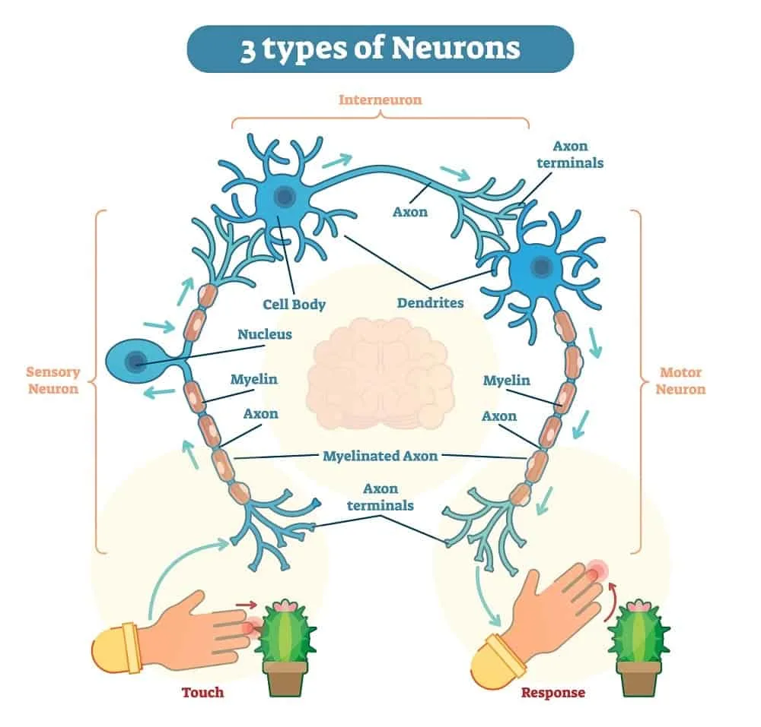

Slide 50
Sensory neurons:
Are the nerve cells that are activated by sensory input from the environment.
Motor neurons:
Are neurons transmit impulses from the spinal cord to skeletal and so directly control all of our muscle movements.
Inter neurons:
Are the ones in between.
They connect spinal motor and sensory neurons.
Transfers signals between sensory and motor neurons.

Slide 51
Electrochemical processes
The neurons show a difference in electrical charge, a potential.
In the membrane of the neuron, the charged atoms (ions) are different from the charged atoms on the outside.
The difference is called membrane potential.
Certain kinds of ions more often or less often than on the inside.
This descent or ascent of concentration is called a Concentration gradient.
we assume that no electrical signals are received from the outside, the membrane potential is −70 mV.
Each ion diffuses predominately to spread out evenly, decreases concentration gradients.

Slide 52
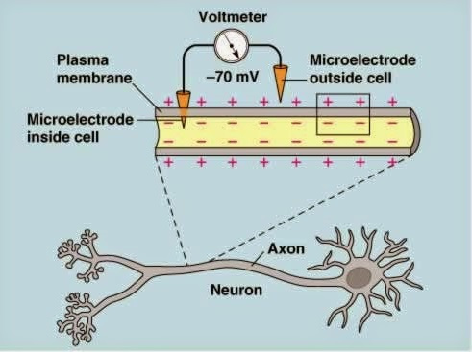

Slide 53
The membrane potential will move towards 0 mV.
There would be no membrane potential anymore.
The membrane itself permits some ions, but not all.
Diffusion happens due to:
Concentration gradient:
If the concentration of an ion is higher on the inside of the neuron than on the outside, it will try to diffuse to the outside and vice versa.
Negative ions, collectively called A−, remains within the neuron since the membrane is not permeable to them.
The inside of the neuron becomes negatively charged.
Electrical Gradient:
The intracellular charge is very strong.
Therefore it attracts positive ions.

Slide 54
The neuron is activated by changes in the membrane potential.
Sodium Na+ and potassium K+ can diffuse through the membrane.
Sodium diffuses slowly, potassium faster.
They move through channels within the membrane, the sodium and potassium channels.
The opening of these channels changes the concentration of ions within and outside of the membrane, it also changes the membrane potential.
These controllable channels are opened as soon as the accumulated received stimulus exceeds a certain threshold
The threshold potential lies at about -55 mV.
As soon as the received stimuli reach this value, the neuron is activated and an electrical signal, an action potential, is initiated.

Slide 55
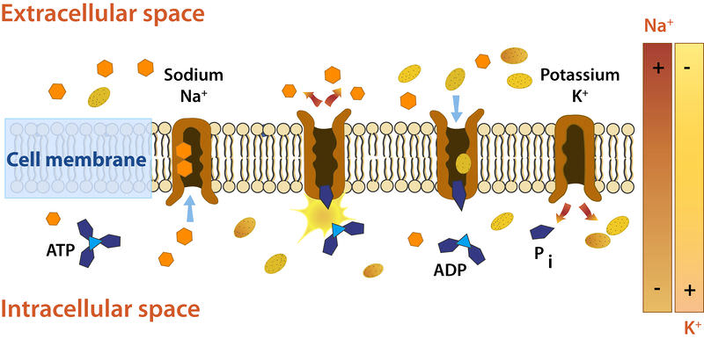

Slide 56
Resting state:
Only the sodium and potassium channels are permeable to open.
The membrane potential is at -70 mV and actively kept there by the neuron.
Stimulus up to the threshold:
A stimulus opens channels so that sodium can pour in.
The intracellular charge becomes more positive.
As soon as the membrane potential exceeds the threshold of -55 mV, the action potential is initiated.
Depolarization:
Sodium wants to pour into the cell because there is a lower intracellular than extracellular concentration of sodium.
The cell is dominated by a negative environment which attracts the positive sodium ions.
This massive influx of sodium drastically increases the membrane potential up to approx. +40 mV i.e., the action potential.

Slide 57
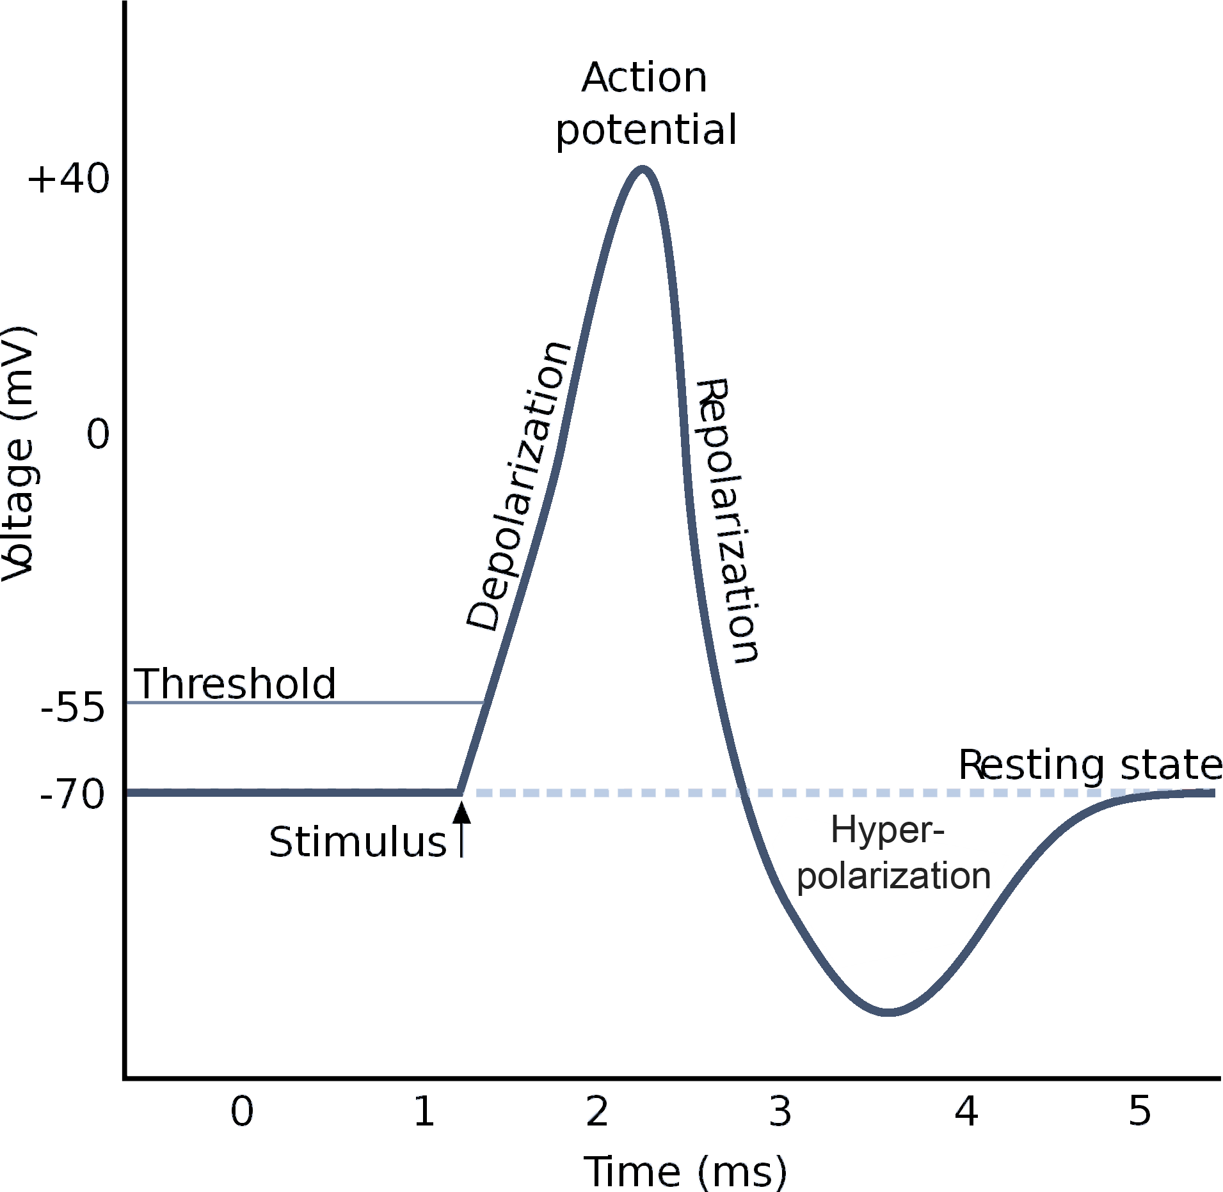

Slide 58
Repolarization:
Sodium channels are closed and the potassium channels are opened.
The positively charged ions want to leave the positive interior of the cell.
The interior of the cell is once again more negatively charged than the exterior.
Hyperpolarization:
Sodium as well as potassium channels are closed again.
At first the membrane potential is slightly more negative than the resting potential.
This is due to the fact that the potassium channels close more slowly.
Positively charged potassium effuses because of its lower extracellular concentration.

Slide 59
After an Action Potential, the Na⁺/K⁺ pump resets the arrangement of Na⁺ and K⁺ ions back to their original positions.
The neuron is then ready to relay another AP when it is called upon to do so.
ATP and ADP are energy-carrying molecule found in the cells of all living things.
Pump binds three sodium – Adenosine Triphosphate and two potassium - Adenosine Diphosphate.
After a refractory period of 1 - 2ms the resting state is reestablished so that the neuron can react to newly applied stimuli with an action potential.
Then the resulting pulse is transmitted by the axon.

Slide 60
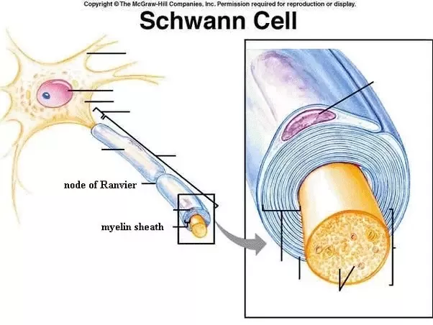

Slide 61
The axon is a long, slender extension of the soma.
It is coated by a myelin sheath that consists of Schwann cells (in the PNS) or Oligodendrocytes (in the CNS).
At a distance of 0.1 to 2mm there are gaps between these cells, called Nodes of Ranvier.
The said gaps are less insulated nodes.
Axon is used to transmit the action potential across long distances.
The action potential is transferred as jumps from node to node.
One action potential initiates the next one.
The pulse "jumping" from node to node is responsible for the name of this pulse conductor: Saltatory conductor.
The pulse will move faster if its jumps are larger.

Slide 62
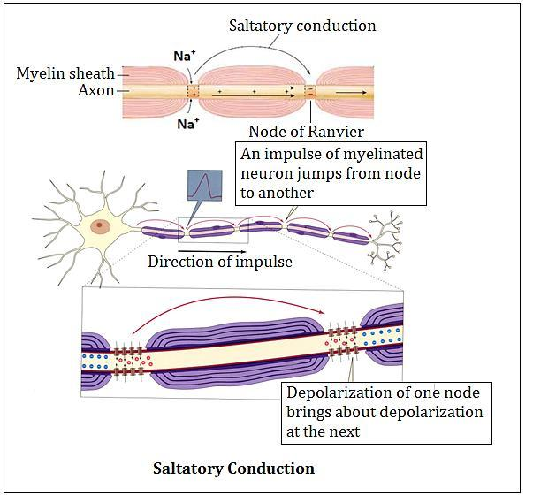

Slide 63
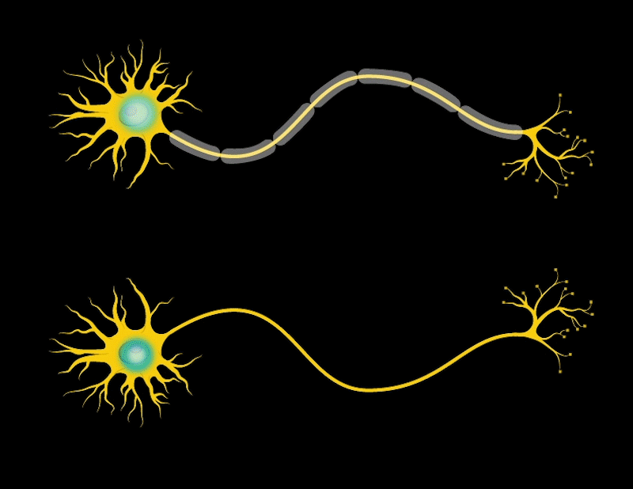
Transmission of signals in a neuron

Slide 64
Receptor
Receptors are highly specialized neurons.
It is the receptor cells that begin the process of sensation and perception.
Sensation:
Sensation is the process of receiving information from the environment through our sensory organs.
Perception:
Perception is the process of interpreting and organizing the incoming information in order to understand and react it accordingly.
A major role of sensory receptors is to help us learn about the environment around us, or about the state of our internal environment.
The cellular structure that transmits environmental stimuli to sensory neurons.
The process of converting that sensory signal to an electrical signal in the sensory neuron is called sensory transduction.

Slide 65
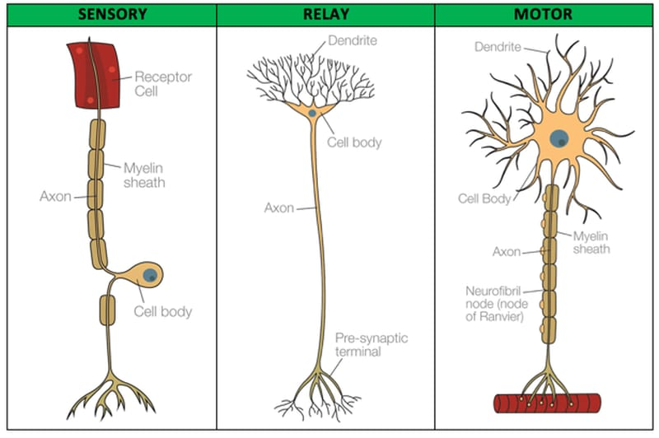

Slide 66
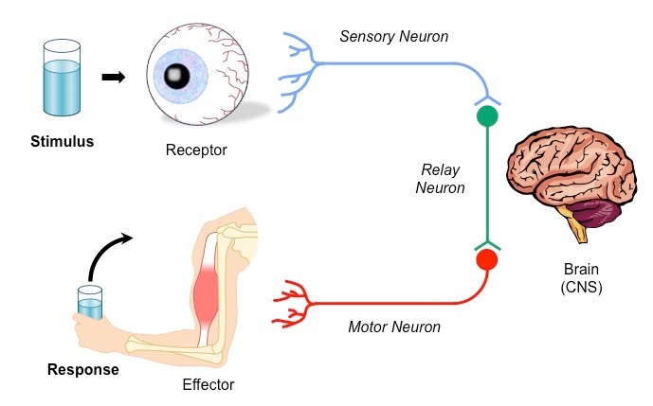

Slide 67
Receptors can receive stimuli within the body, called interoceptors as well as stimuli outside of the body called exteroceptors.
The stimulus energy itself is too weak to directly cause nerve signals.
The signals are amplified either during transduction or by means of the stimulus-conducting apparatus.
Few stimulus-conducting apparatus:
Photoreceptors - respond to light intensity and color
Mechanoreceptors - detect vibrations conducted from the eardrum.
Olfactory receptors - recognize molecular features of odors.
The resulting action potential can be processed by other neurons and is then transmitted into the thalamus.

Slide 68
Thalamus which is a gateway to the cerebral cortex, prevents an abundance of information to be managed.
There are different receptor cells for various types of perceptions.
Primary receptors:
Each of the many types of receptor cells must convert, or transduce, its sensory input into an electric signal.
A few sensory cells are themselves neurons that generate action potentials in response to stimulation, transmit their pulses directly to the nervous system.
A good example for this is the sense of pain.
Secondary receptors:
Continuously transmit pulses.
These pulses control the amount of the related neurotransmitter, which is responsible for transferring the stimulus.

Slide 69
Information Processing
Information is processed on every level of the nervous system.
All received information is transmitted to the brain and processed there.
The brain ensures that it is "output" in the form of motor pulses.
The information processing is entirely decentralized.
Information is processed in the cerebrum, which is the most developed natural information processing structure.
The midbrain and the thalamus, as a gateway to the cerebral cortex,
The filtering of information is a very important method of information processing, too.

Slide 70
The receptor cells, the information is not only received and transferred but directly processed.
Due to continuous stimulation many receptor cells automatically become insensitive to stimuli.
Even before a stimulus reaches the receptor cells, information processing can already be executed by a preceding signal carrying apparatus.
The external and the internal ear have a specific shape to amplify the sound, which allows in association with the sensory cells of the sense of hearing.
The sensory stimulus only to increase logarithmically with the intensity of the heard signal.

Slide 71
Light sensing organ
Sensory organs can detect electromagnetic radiation.
The wavelength range of the radiation perceivable by the human eye is called visible range or simply light.
The different wavelengths are perceived by the human eye as different colors.
Fast flying insects (dragon fly) and crustaceans (crabs, lobsters, crayfish, shrimps) are example of compound eye.
The compound eye consists of a great number of small, individual eyes.
Each individual eye has its own nerve fiber which is connected to the insect brain.
The spatial resolution, of compound eyes must be very low and the image is blurred.

Slide 72
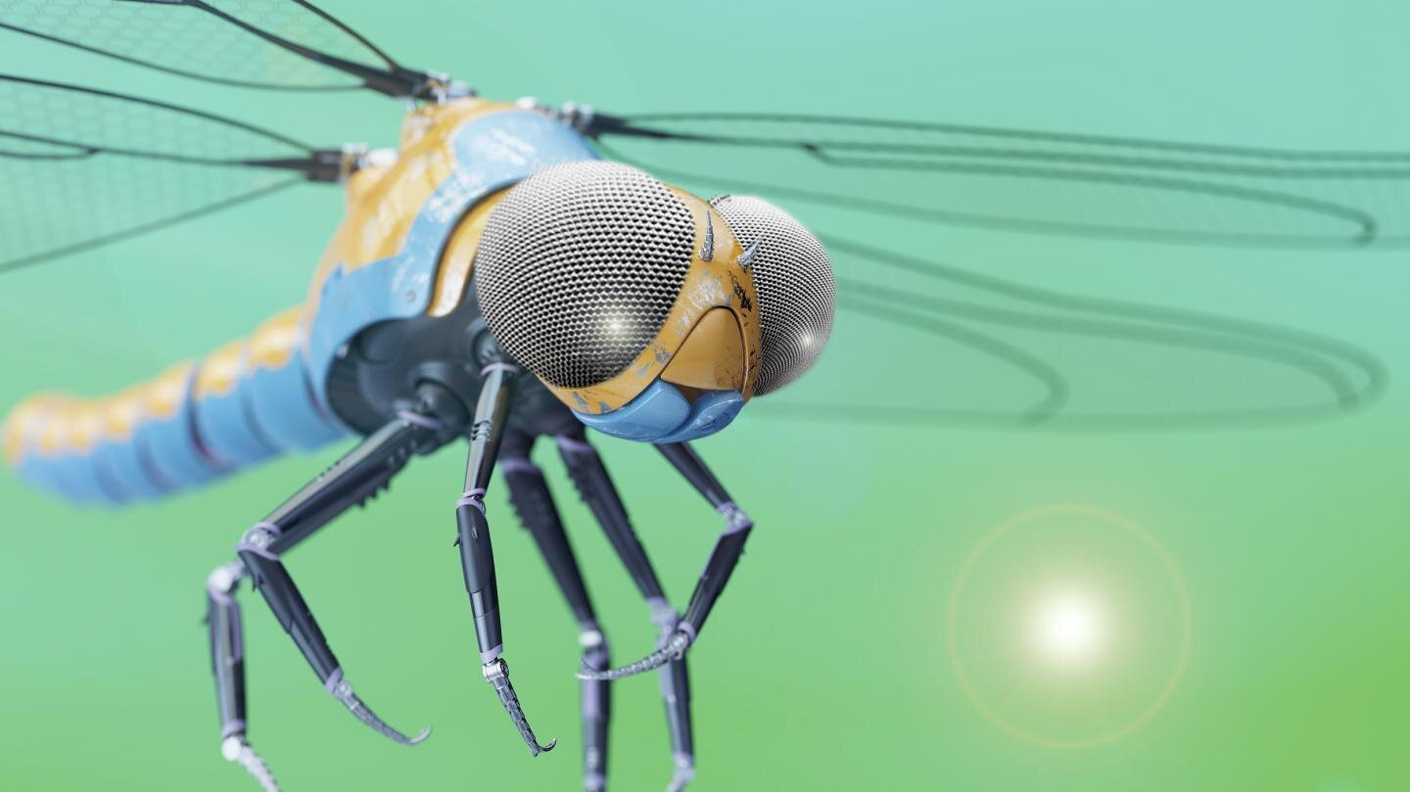
Compound eye

Slide 73
Octopus species are example of Pinhole eyes, similar to a pinhole camera.
A pinhole eye has a very small opening for light entry.
It projects a sharp image onto the sensory cells behind.
The spatial resolution is much higher than in the compound eye.
Single lens eyes combine the advantages of the other two eye types, but they are more complex.
The light sensing organ common in vertebrates is the single lens eye.
The resulting image is a sharp, high-resolution image of the environment at high or variable light intensity.
Lens eyes with their high angular resolution seem to more useful for pattern recognition, whereas the compound eyes, with their poor resolution, specialized for movement perception.

Slide 74
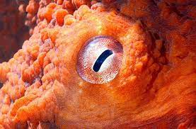
Pinhole eye

Slide 75
Light enters through an opening (Pupil) and is projected onto a layer of sensory cells in the eye (Retina).
The size of the pupil can be adapted to the lighting conditions by means of the iris muscle.
These differences in pupil dilation require to actively focus the image.
The single lens eye contains an additional adjustable lens.
The retina not only receive information but is also responsible for information processing, done by several layers of information processing cells.
The components of the neural retina are:
The photoreceptors.
Horizontal cell.
Bipolar cell.
Amacrine cell.
Ganglion cell.

Slide 76
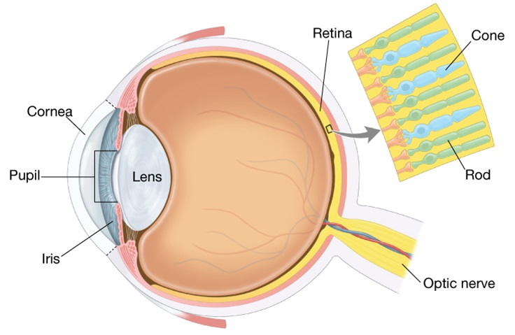

Slide 77
Photoreceptors:
The deepest layer of neurons processes the light first.
Rods are responsible for vision at low light levels.
Cones are active at higher light levels, are capable of color vision.
The only cells in the retina that can convert light into nerve impulses (cause action potentials).
Photoreceptor layer then transmits these impulses next layers, namely to bipolar neurons and on to ganglion neurons.
Horizontal cells and Bipolar cells:
The horizontal cells receive information from the photoreceptors and transmit it to a number of surrounding bipolar neurons.
Bipolar cells are responsible for transmitting signals from photoreceptors to a retinal ganglion cell.

Slide 78
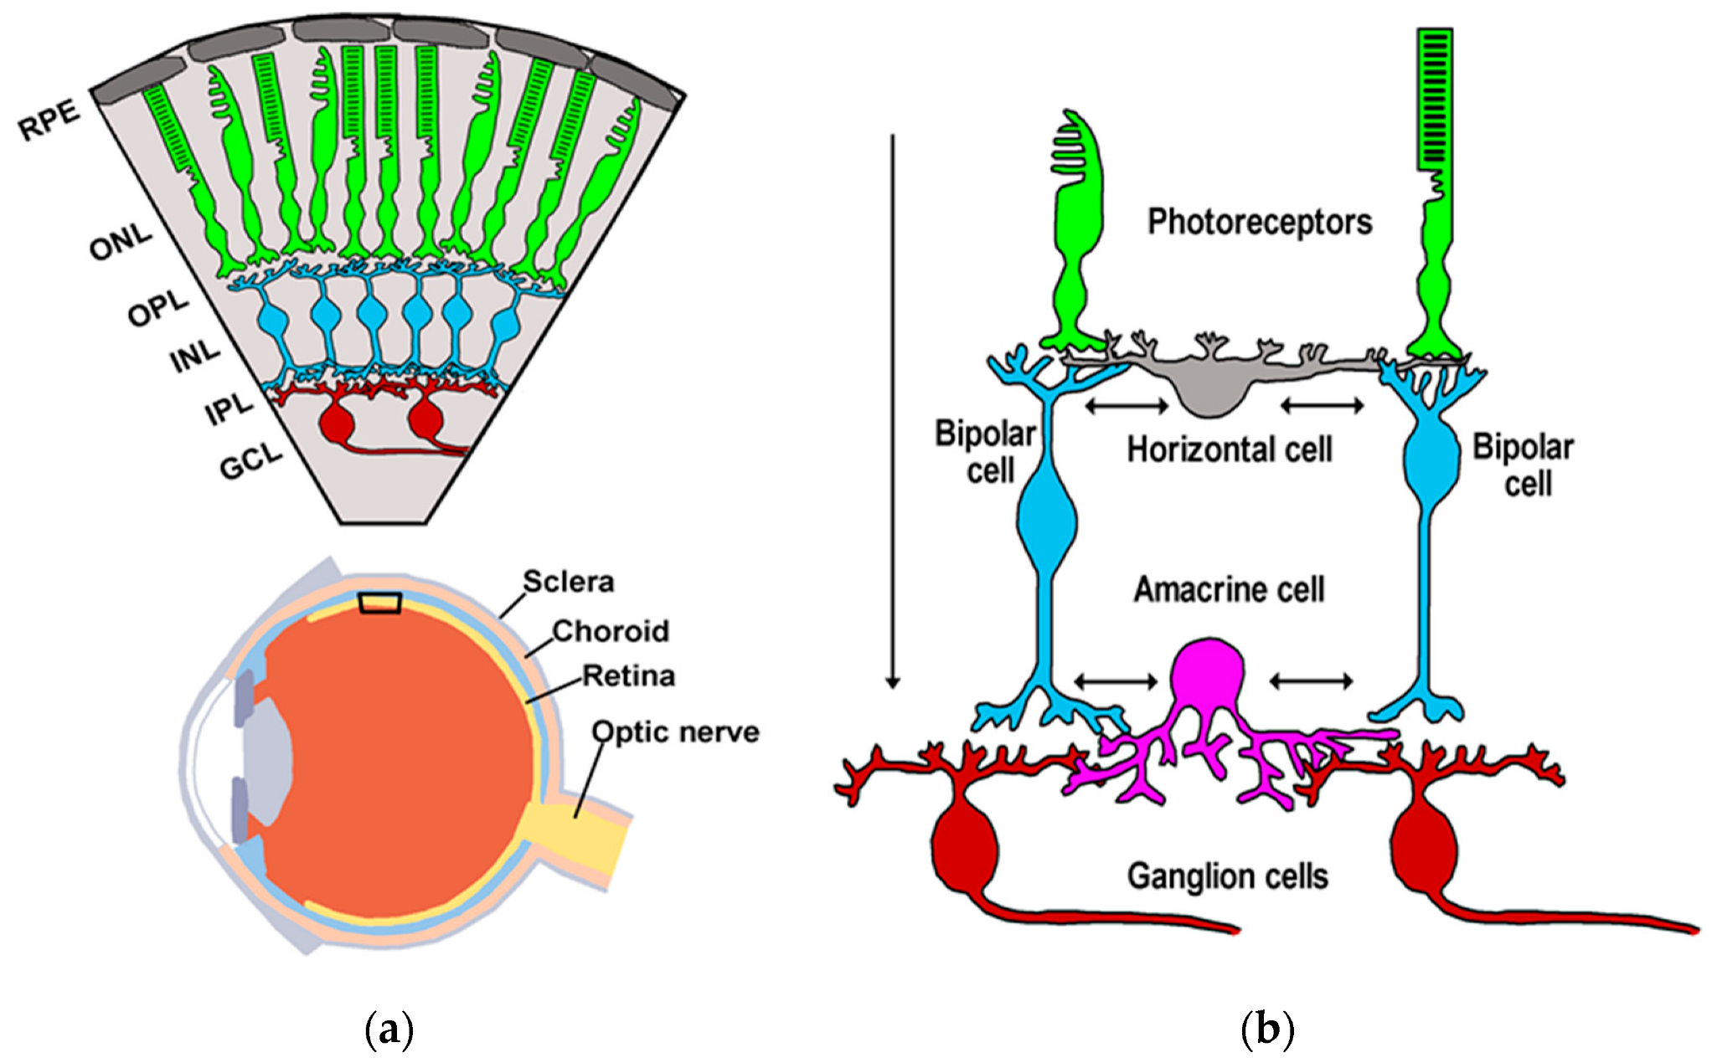

Slide 79
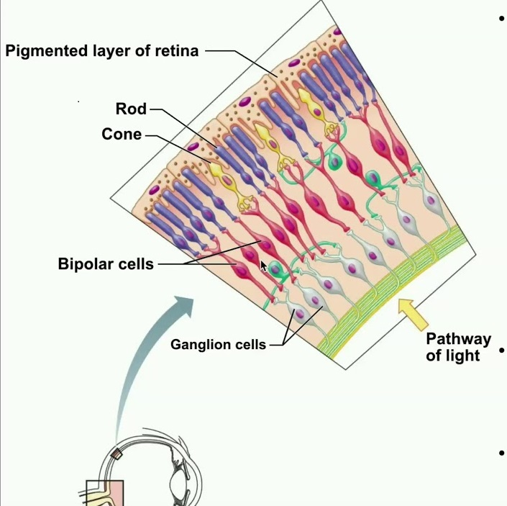

Slide 80
Amacrine cell and Ganglion cell:
The amacrine cells receive their inputs from the bipolar cells and transmits to the ganglion neurons.
Ganglion cell relays signals from bipolar and amacrine cells to the brain through long projections, optic nerve.
The bipolar and horizontal cells respond to the glutamate (glu) released by the photoreceptor cells.
The bipolar cells have two different functional properties:
The active bipolar cells are depolarized by glu and inhibits ganglion cells.
Ganglion cells detect light objects in a darker background.
The inhibit bipolar cells are hyperpolarized by glu and activates ganglion cells.
Ganglion cells detect dark objects in a lighter background.

Slide 81
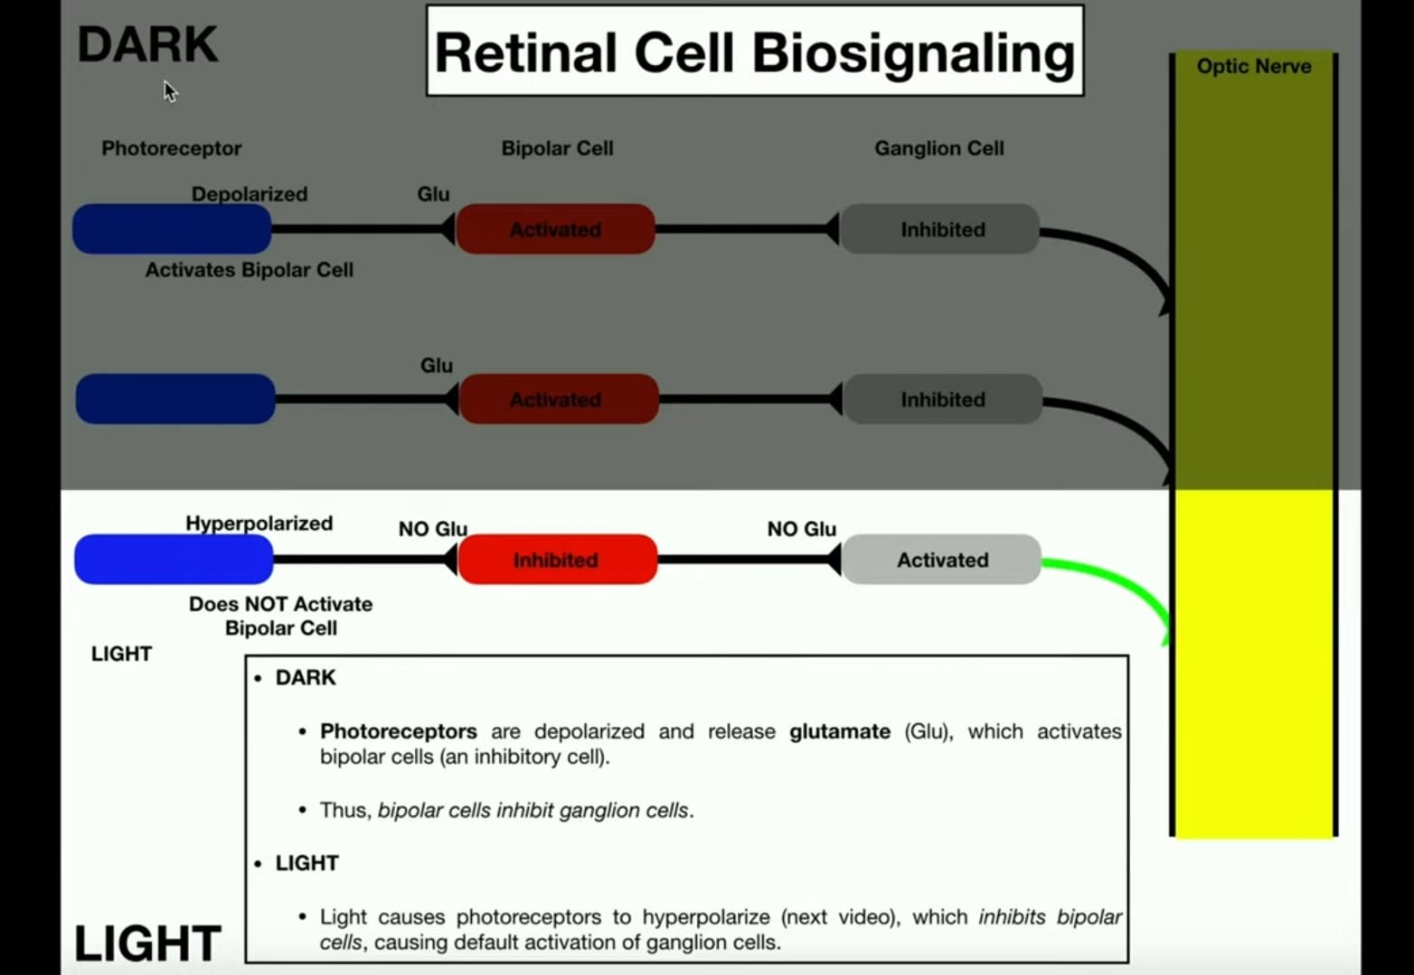

Slide 82
The amount of neurons in living organisms at different stages of development
An overview of different organisms and their neural capacity:
302 neurons:
Nematode worm, are the most numerous multicellular animals on earth.
Nematodes live in the soil and feed on bacteria.
10⁴ neurons:
An ant, due to different attractants and odors, ants engage in complex social behavior.
It has a cognitive capacity similar to a chimpanzee or even a human.
10⁵ neurons:
A fly, it can land upon the ceiling upside down, has a considerable sensory system because of vibrissae, nerves at the end of its legs.
A fly is not easy to catch, the bodily functions are also controlled by neurons.

Slide 83
0.8x10⁶ neurons:
A honeybee, build colonies and have amazing capabilities in the field of aerial reconnaissance and navigation.
4.0x10⁶ neurons:
A mouse, the world of vertebrates already begins.
1.5x10⁷ neurons:
A rat, an animal which is extremely intelligent, have an extraordinary sense of smell and orientation.
The brain of a frog has a complex build with many functions, it can swim and has evolved complex behavior.
5.0x10⁷ neurons:
A bat, can navigate in total darkness in a room to several centimeters, by only using their sense of hearing. It uses acoustic signals to localize insects and eats its prey while flying.
A mouse, the world of vertebrates already begins.

Slide 84
1.6x10⁸ neurons:
A dog, companion of man for ages.
3.0x10⁸ neurons:
A cat, which is about twice as much as in a dog. Cats are very elegant, patient carnivores that can show a variety of behaviors.
6.0x10⁹ neurons:
A chimpanzee, one of the animals being very similar to the human.
10¹¹ neurons:
A human, has considerable cognitive capabilities.
2.0x10¹¹ neurons:
Elephants and certain whale species.

Slide 85
Transition to technical neurons
The biological neurons are linked to each other in a weighted way and when stimulated they electrically transmit their signal via the axon.
From the axon they are not directly transferred to the succeeding neurons.
They first have to cross the synaptic cleft where the signal is changed again by variable chemical processes.
The receiving neuron the various inputs that have been postprocessed in the synaptic cleft are summarized or accumulated to one single pulse.
Vectorial input: The input of technical neurons consists of many components, therefore it is a vector.

Slide 86
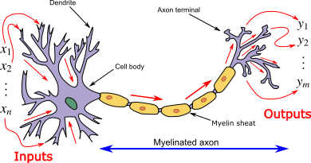

Slide 87
Scalar output: The output of a neuron is a scalar, which means that the neuron only consists of one component. Several scalar outputs in turn form the vectorial input of another neuron.
Synapses change input: In technical neural networks the inputs are preprocessed, too. They are multiplied by a number (the weight) – they are weighted.
Accumulating the inputs: In biology, the inputs are summarized to a pulse according to the chemical change. After accumulation we continue with only one value, a scalar, instead of a vector.
Non-linear characteristic: The input of our technical neurons is not proportional to the output.
Adjustable weights: The weights weighting the inputs are variable, similar to the chemical processes at the synaptic cleft. This adds great dynamic to the network because power of chemical processes in cleft.

Slide 88
